Slide 1

Machine learning on Python
Andromeda IT

Slide 2

So What is Machine learning?
A set of algorithms that learn from example and experience instead of relying on hardcoded rules.

Slide 3

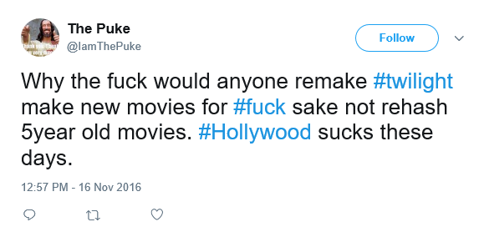
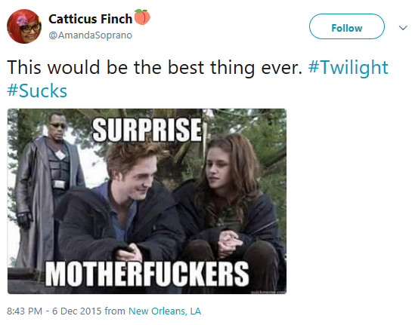
Why this is useful?
There are some problems that sound trivial but are actually almost impossible to solve without machine learning.
Notes:
Let's imagine that we are working on a movie studio, and that you are tasked with a software that analyzes random people's tweets of about the Twilight movie because they want to know if is a good idea to make a remake.
How would you even do it?
1. Use the twitter API and gets all the current tweets where people mention the movie twilight.
2. Analyze the string to find negative and positive adjectives and start counting them?
What would you do if there is negation before an adjective? "This movie is not good!"

Slide 4
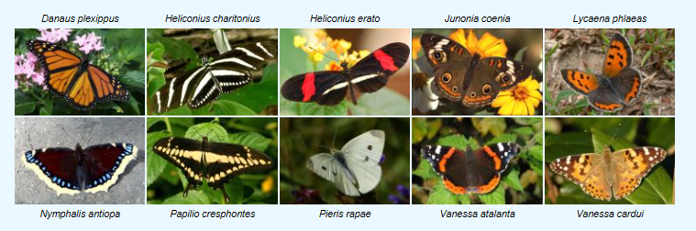
Which butterfly is which?
http://www.comp.leeds.ac.uk/scs6jwks/dataset/leedsbutterfly/
Notes:
Do you think that was hard?
Imagine that you work for a research organization that is currently analyzing the migration patterns of butterflies, and that is currently analyzing thousands of pictures that people have send them.
The task is pretty simple: Make a function that tells the type of butterfly on a given picture.

Slide 5
Types of problems?
Notes:
Machine learning tasks are typically classified into three broad categories, depending on the nature of the learning.

Slide 6
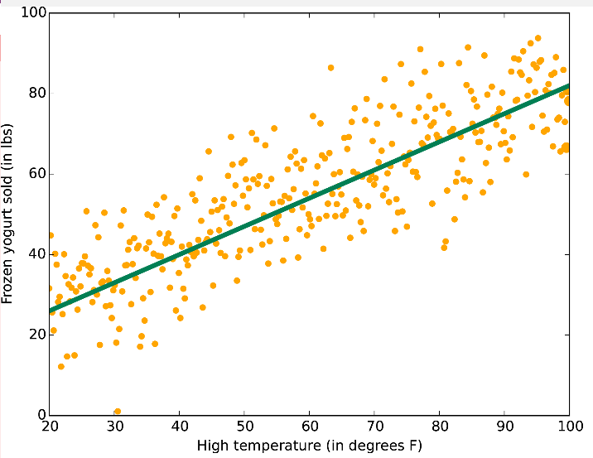
Knowledge of output - learning with the presence of an "expert/ teacher“.
Data is labelled with a class or a value
Goal: predict class, value label, or regression point
-e.g. Neural Network, Support Vector Machines, Decision Trees, Bayesian Classifiers …
Supervised
learning
Notes:
Example: Zillow house price estimator, dating sites recommendation algorithms, spam detector…

Slide 7
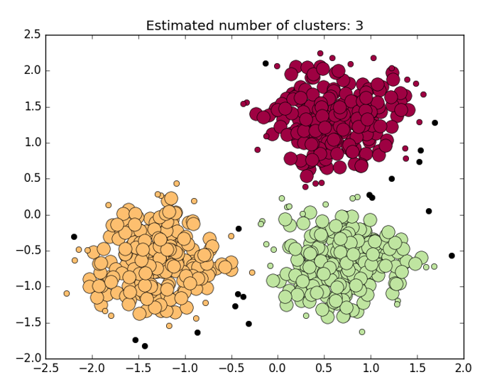
No knowledge of output class or value
Data is unlabeled or value unknow
Goal: determine data patterns or cluster.
e.g. k-means, genetic algorithms, clustering, …
Unsupervised learning
Notes:
Example: Given a collection of text documents, we want to organize them according to their content similarities. You don't even know what the contents are so you don't have any idea what the clusters could be (or how many)

Slide 8
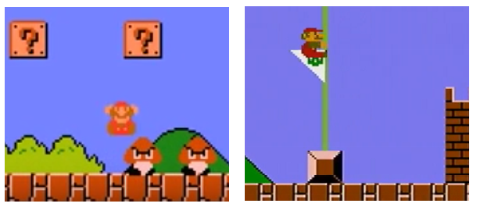
A computer program interacts with a dynamic environment in which it must perform a certain goal (such as driving a vehicle or playing a video game). The program is provided feedback in terms of rewards and punishments as it navigates its problem space.
Reinforcement learning
MarI/O - Machine Learning for Video Games
Notes:
At each point in time:
Select action using policy (In the Mario case the actions are either moving Mario left or right, and/or pressing the jump button). Part of the policy will be to select actions randomly.
Action!
Observe the reward associated with the transition
Update the policy (learning step) (Why do I mean with this? It would be something like: "When Mario is on second 34, on the second step of the first Stairs, then jump and move right" - since that is what is going to give the biggest reward.
Iterate until optimal reward is found

Slide 9
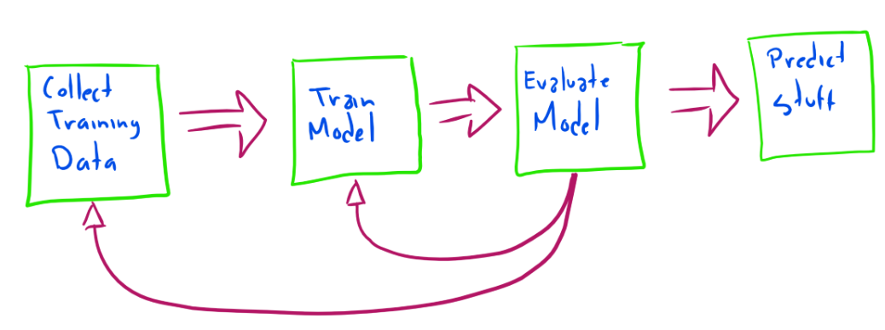
ML Recipe

